Slide 1
24MAT120
S2 P/M

Slide 2
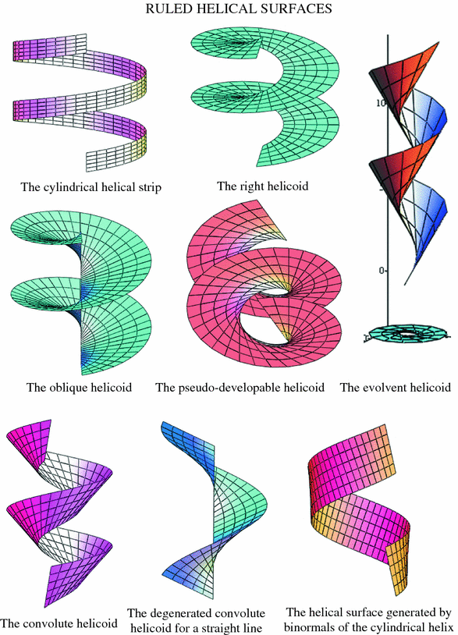
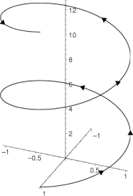

Slide 3
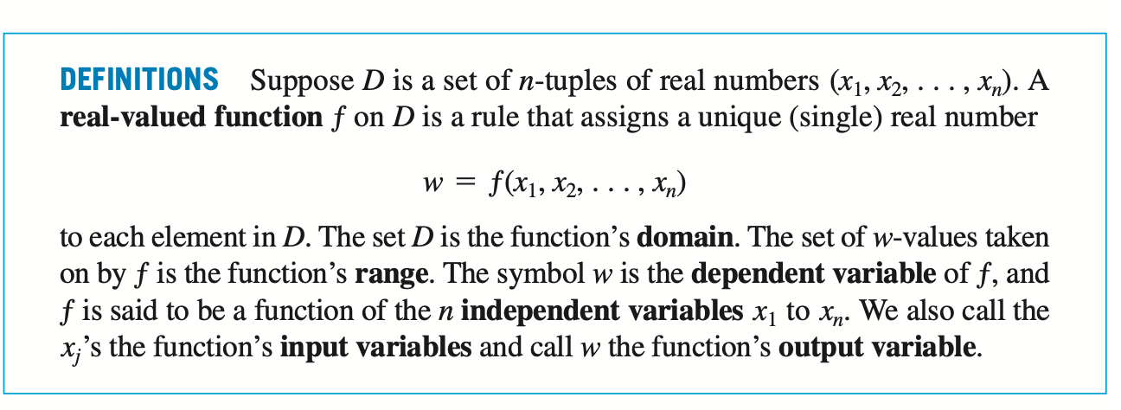

Slide 4
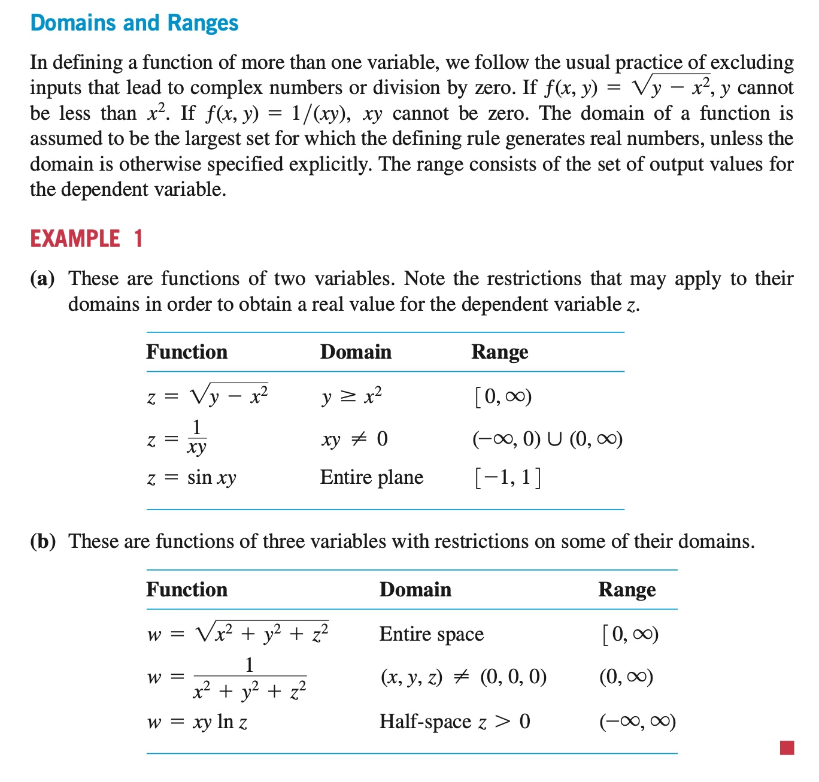

Slide 6
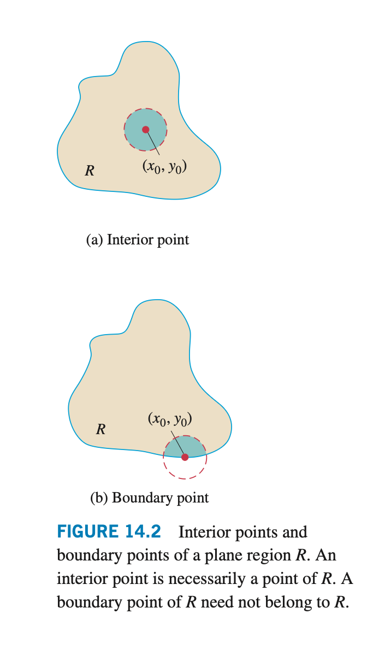

Slide 7
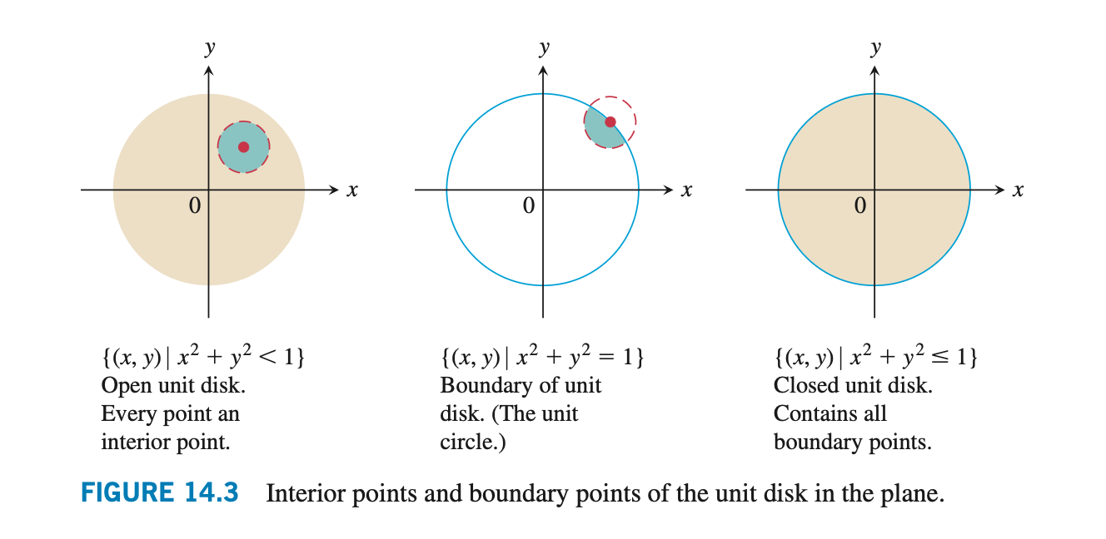

Slide 8


Slide 9
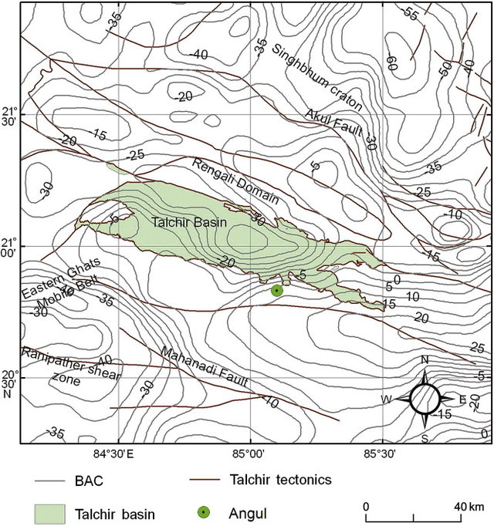

Slide 10


Slide 11
If the surface z = f(x, y) is cut by the horizontal plane z = k, then at all points on the intersection we have f(x, y)= k.
The projection of this intersection onto the xy-plane is called the level curve of height k or the level curve with constant k.
A set of level curves for z = f(x, y) is called a contour plot or contour map of f.

Slide 12
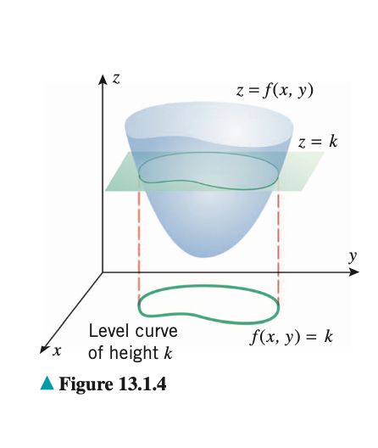

Slide 13
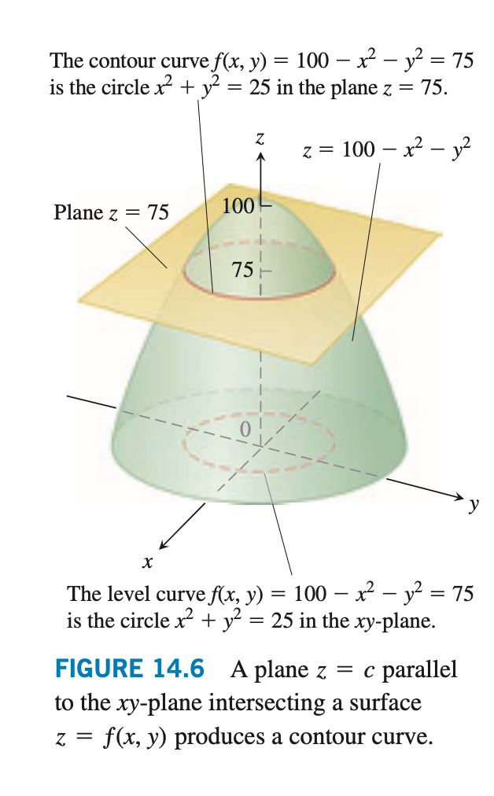

Slide 14
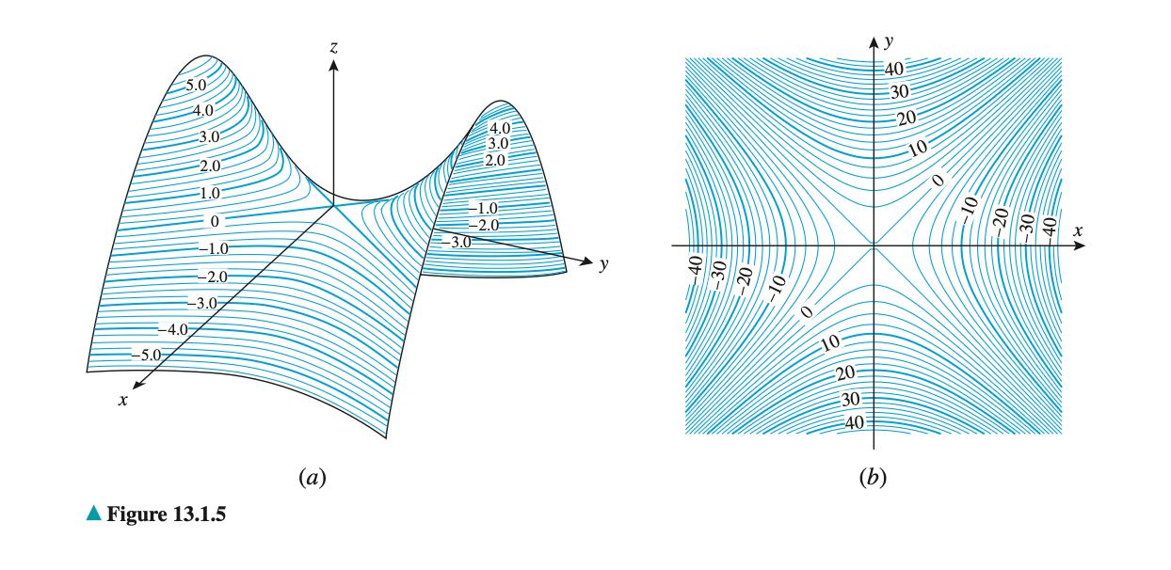

$${z=y}^{2}−x^{2}$$

Slide 15
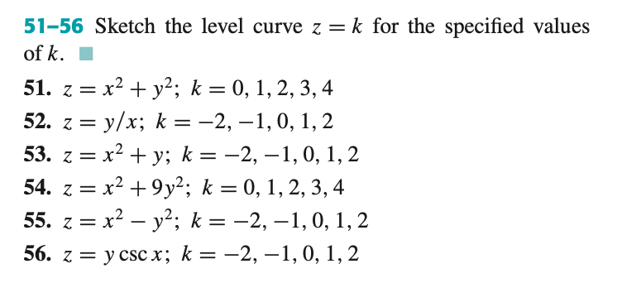

Slide 16
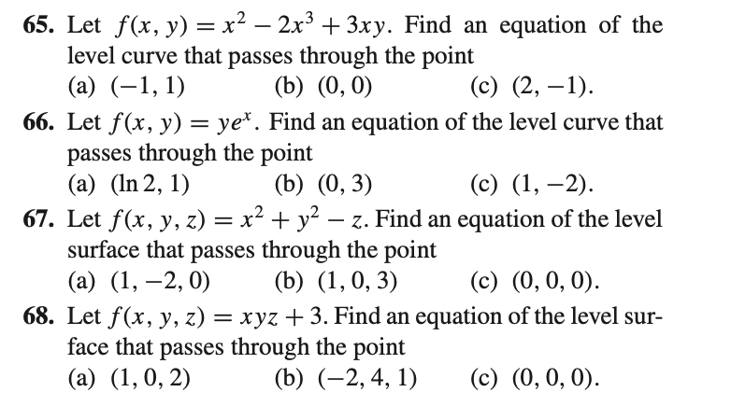

Slide 17
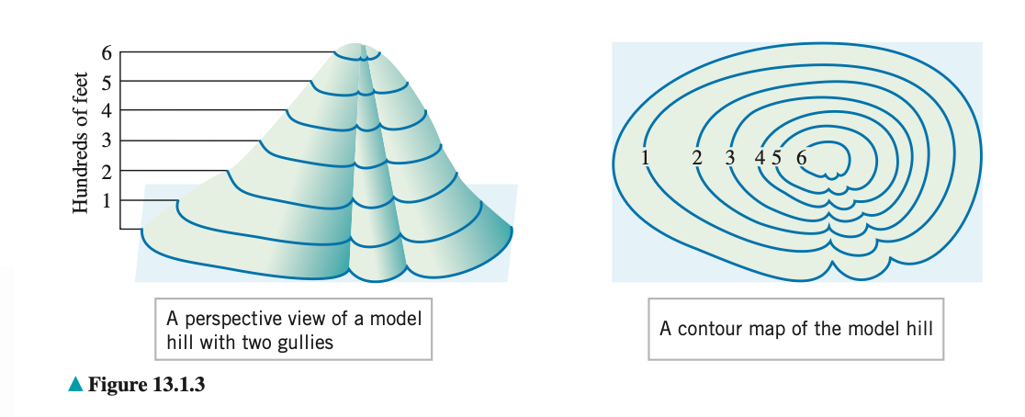

Slide 18
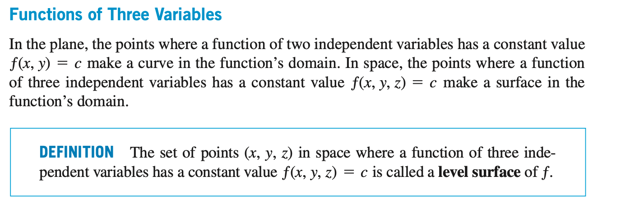

Slide 19
